Slide 1
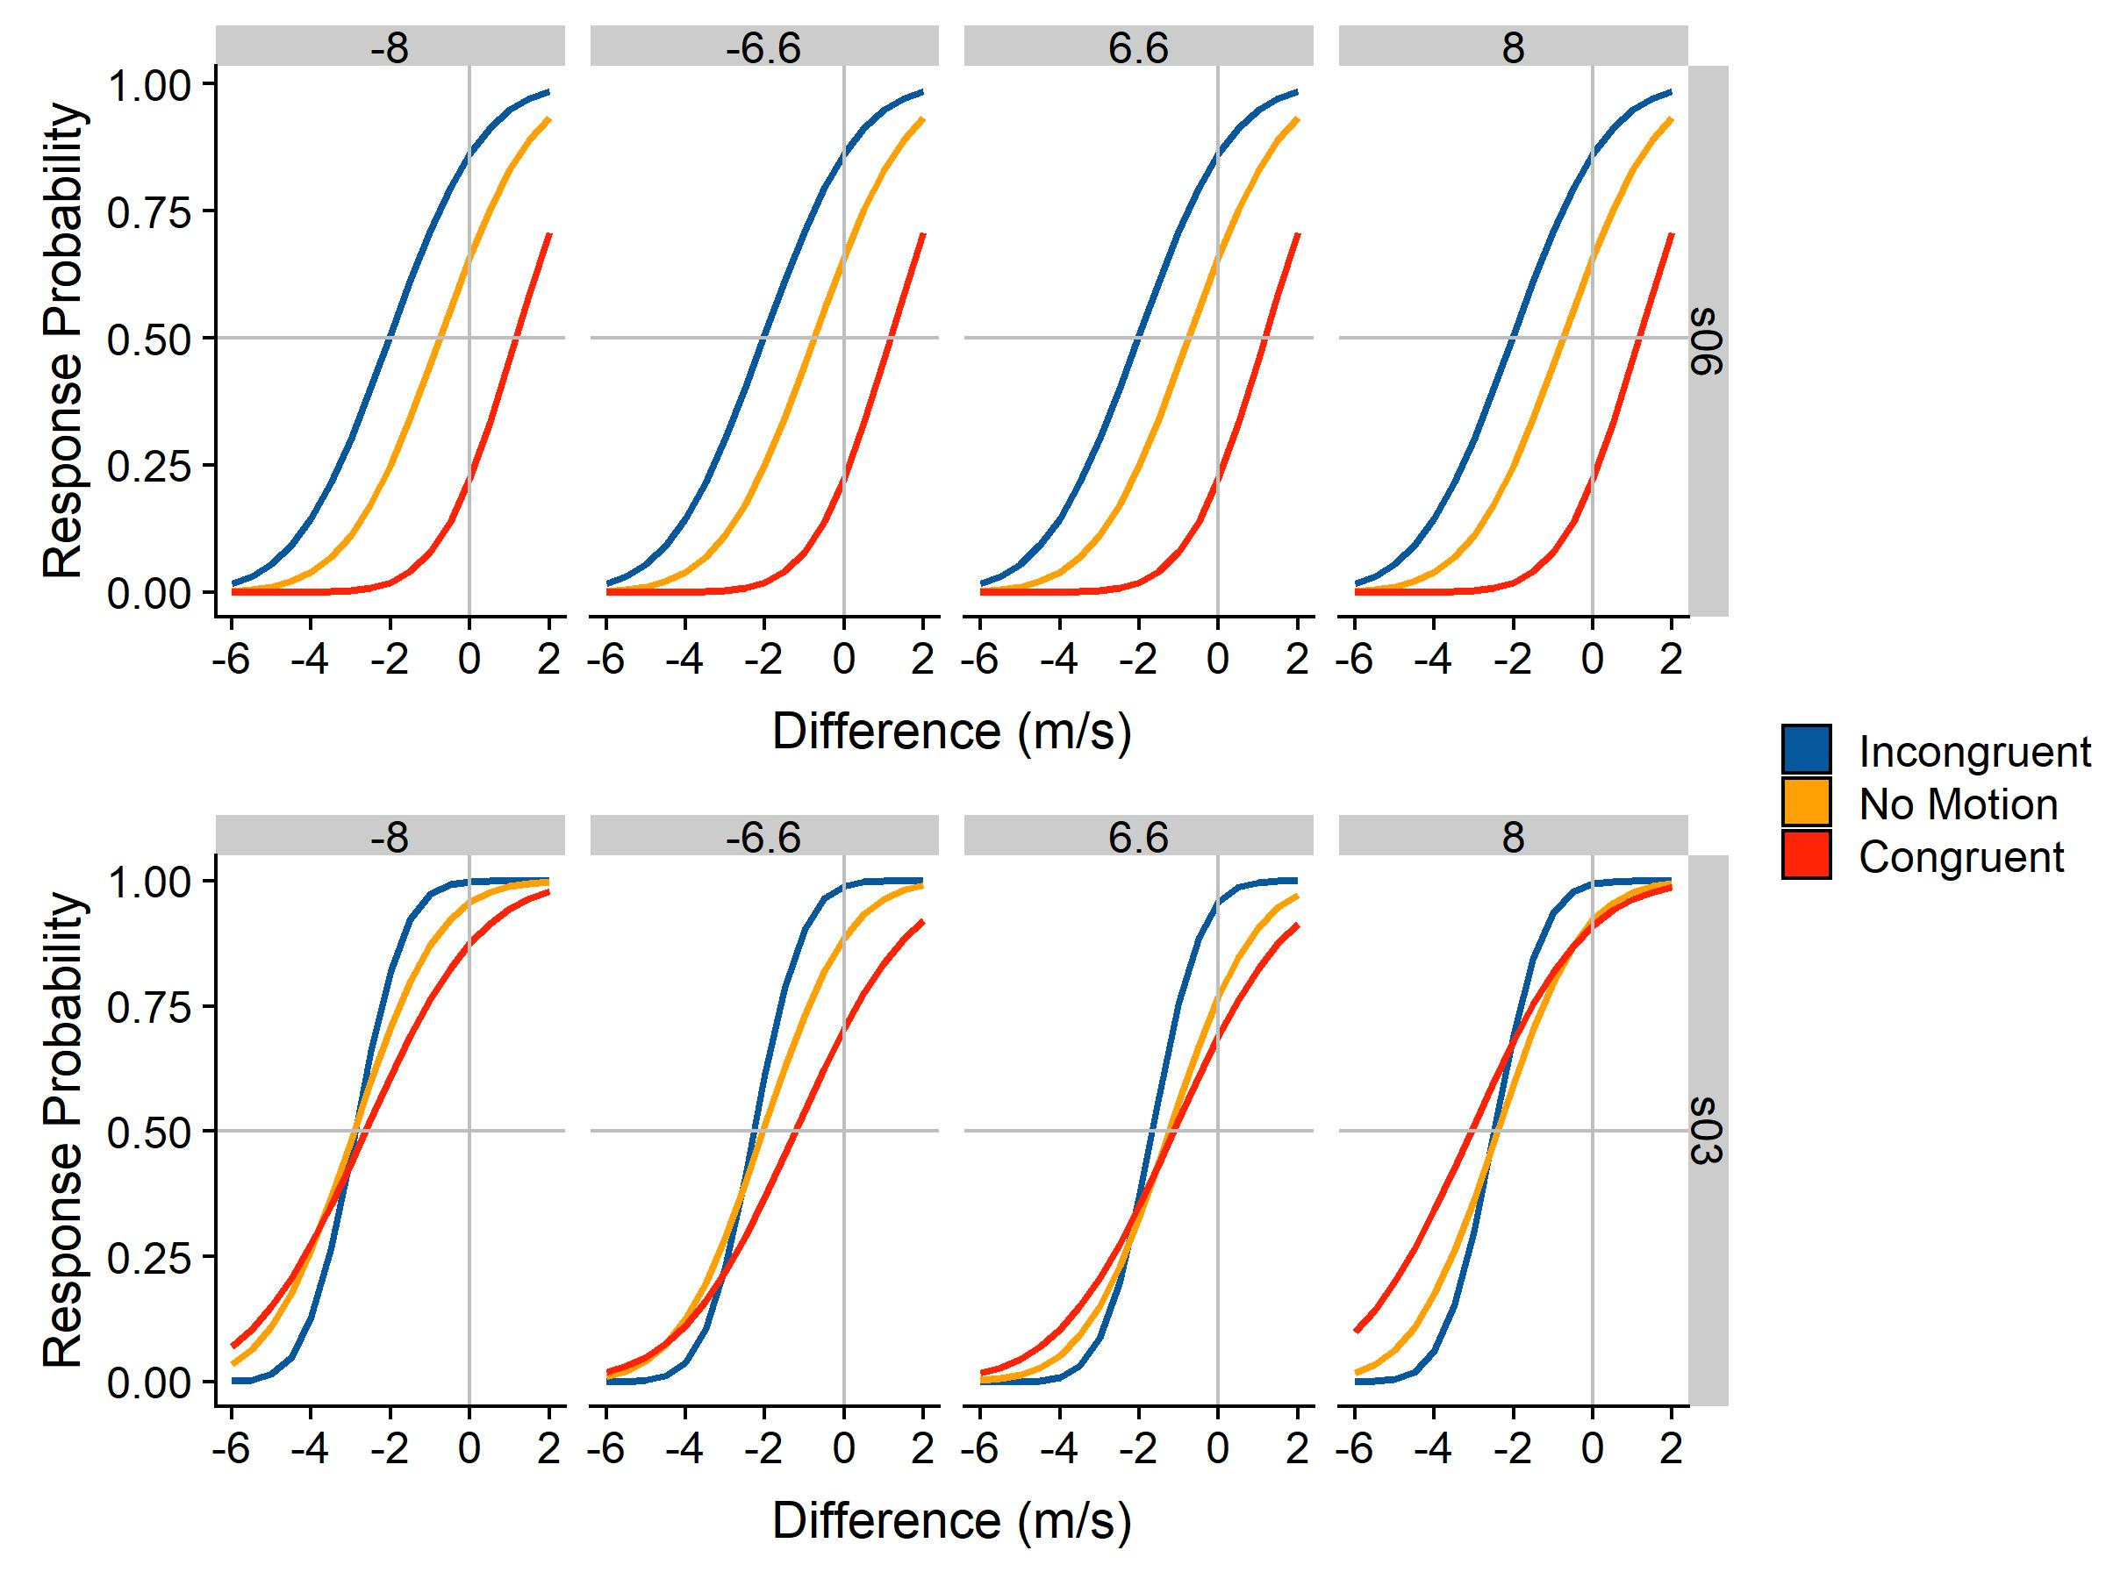
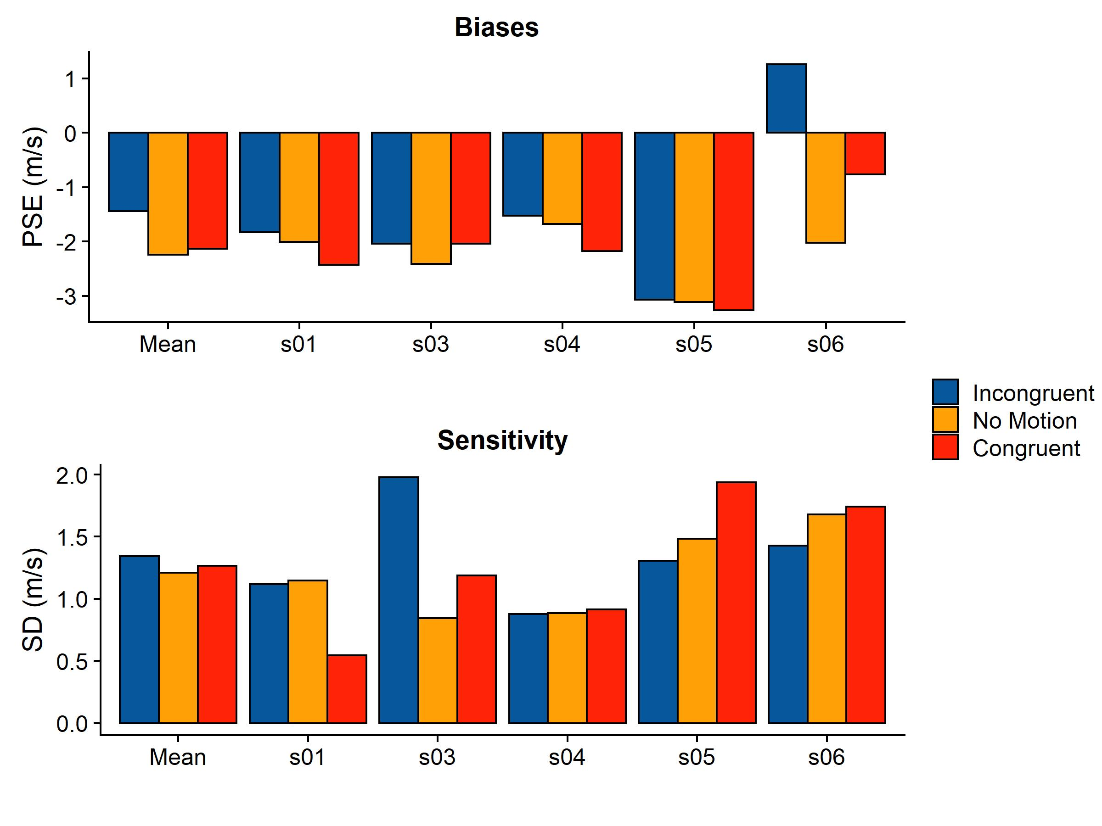
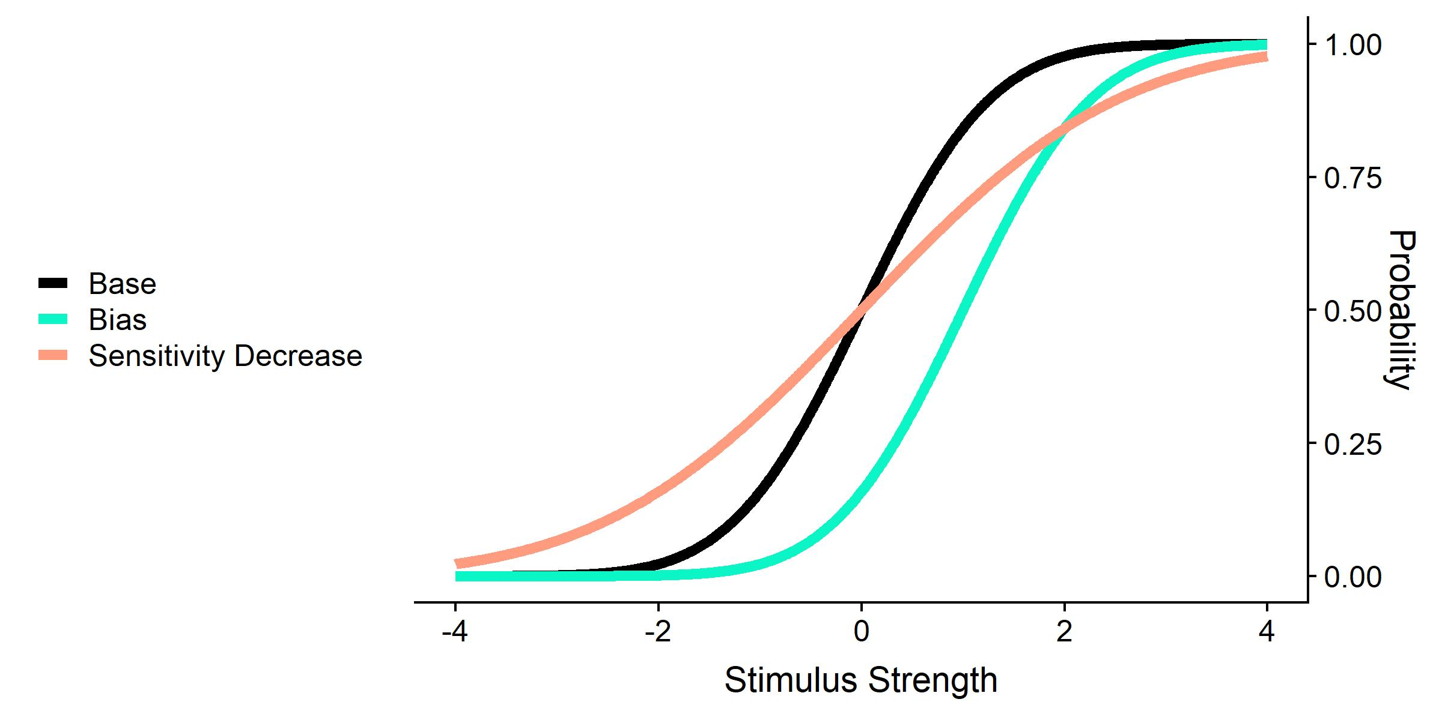
Accuracy and Precision in Velocity Estimation during Visual Self-Motion
Björn Jörges, Laurence Harris
Center for Vision Research, York University
Background & Objective
Results
Retinal motion elicited by an object is ambiguous and can be due to:
Object-Motion
Self-Motion
Both
Do humans discount visually experienced self-motion successfully from object motion? Does this come at a price?
Hypotheses: Congruent self-motion and object motion lead to an underestimation of target velocity and vice-versa. Self-Motion generally leads to noisier judgments.
Methods
The tasks
Which of two presented motions is faster?
The stimuli
Two intervals of left or rightwards motion presented at eye-height in 3D virtual environment
One big target (moving at 6.6 m/s or 8 m/s), one ball cloud (velocity adjusted according to subject’s performance)
Subject is moved visually in the same or opposite direction as the target, or could remain static during observation of the big target
Dependent variables
Mean (= accuracy) and slope (= precision) of psychometric function
Participant 06: Bias to perceive incongruent motion as faster than congruent motion
Participant 03: Sensitivity higher without Self-Motion
All Participants
What is a psychometric function?
On average, incongruent motion is judged as too fast; no big difference between no motion and congruent motion
On average, subjects judge speed somewhat less precisely when self-motion is simulated
Conclusions
Mean of Cummulative Gaussian indicates biases: does the target look faster in one condition than in another?
Slope of Cummulative Gaussian indicates sensitivity: how well do subjects do at discriminating different velocities?
Everything is (still) a huge mess
Hypotheses are partially confirmed:
Incongruent motion is perceived as faster than congruent motion/no motion
Both congruent and incongruent self-motion elicit lower sensitivity
References
[1] Dokka, K., MacNeilage, P. R., DeAngelis, G. C., & Angelaki, D. E. (2015). Multisensory self-motion compensation during object trajectory judgments. Cerebral Cortex, 25(3), 619–630. https://doi.org/10.1093/cercor/bht247
[2] Dupin, L., & Wexler, M. (2013). Motion perception by a moving observer in a threedimensional environment. Journal of Vision, 13(2), 1–14. https://doi.org/10.1167/13.2.15
Contact: bjoerges@yorku.ca, or Twitter: @b_jorges

